Slide 1



TELEMED – APP PITCH DECK
01

Slide 2


Healthcare Access Problem
Millions of people lack access to quality healthcare due to location, time or financial constraint.
Traditional healthcare models are often time consuming, expensive and inefficient.
COVID-19 showed need for remote healthcare
10

Slide 3

Telemedicine platform connects patients with doctors for online consultation through Video calls, chat support and is accessible anywhere in the world
06

Slide 4
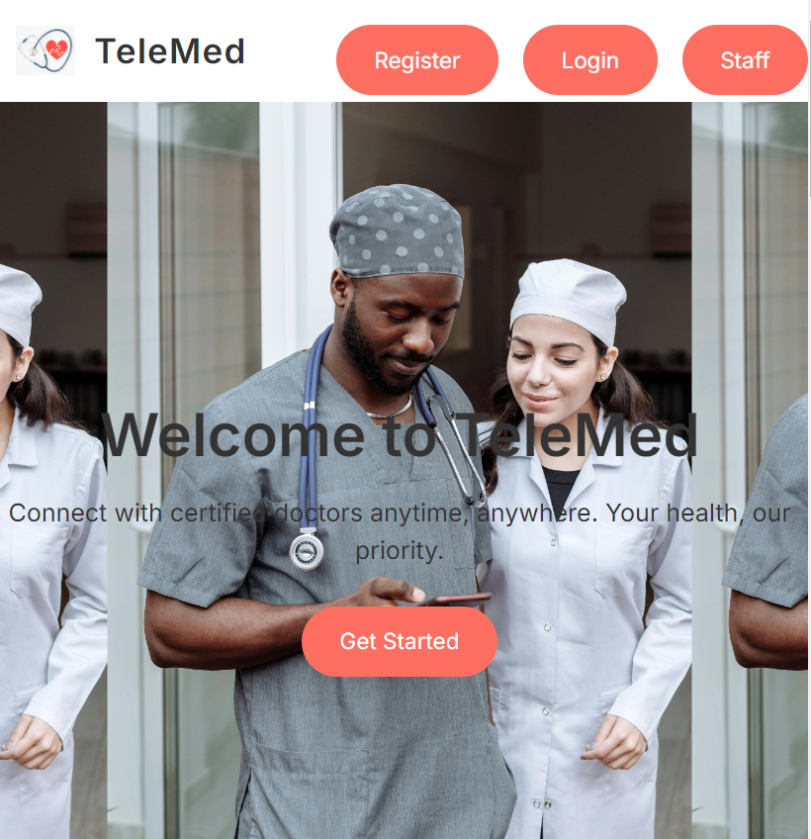
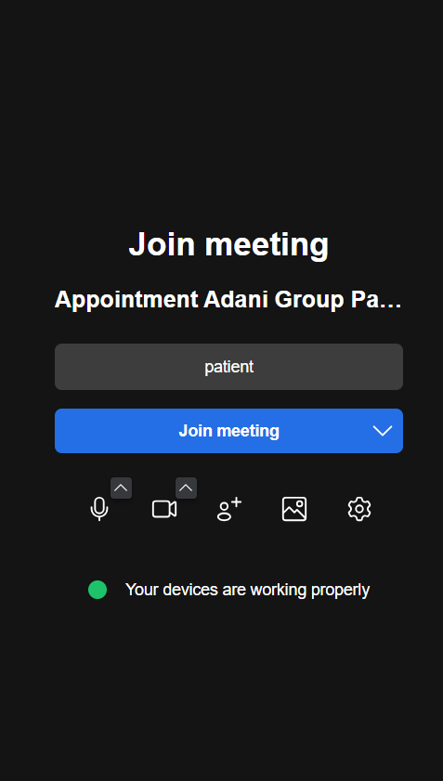
Product
Telemed platform connects patients doctors for online consultations.
Features Video calls, chat support, medical record sharing and remote monitoring
It is accessible anywhere, no wait in long lines or Travel
04

Slide 5



Target Market
3 out 5
Prefer remote healthcare solutions post pandemic.
65%
Adoption of Telemedicine has been increasing steadily at 65% in 2024.
$185.6B
As per data published by Grand View Research, telemedicine market is expected to grow by $45b by 2026.
14

Slide 6
Market Size

Slide 7
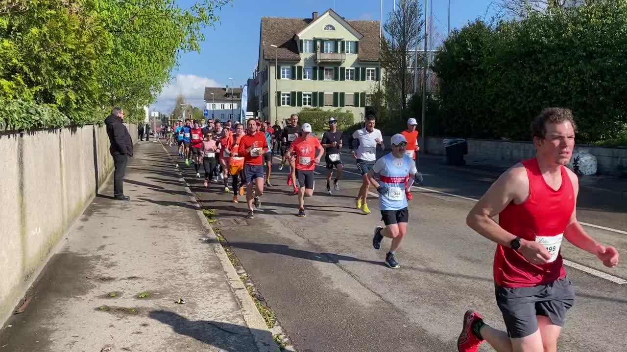
Competitors
Teladoc
Doctor on Demand
23

Slide 8

Competitive Advantage
More affordable pricing plans
Better integration with local pharmacies and health insurance
Specialized Healthcare services
Superior user experience and app interface

Slide 9
Project Traction
Tasks
Month 1
Month 2
Month 3
Month 4
Month 5
Register Users
Register Doctors
Monetization
Partnerships
Technological Advancement
Regulatory compliance
23

Slide 10

Business Model
Subscription Model – Yearly subscription by doctors and 10% charge on patients consultation fees paid to doctors.
Data Analytics – offering aggregated data insights to medical organizations.
23

Slide 11
Go To Market
Digital Marketing- Paid ads, social media campaigns
Influencers and Brand Ambassadors – Partnering with health influencers to promoting app.
Referral Programs – offering incentive to new users.
Corporate wellness Programs – Partnering with employers to offer their employees telemedicine services.
Expanding Partnerships – collaborating with insurance providers to integrate telemedicine

Slide 12
Social Impact
We are leveraging technology and digital infrastructure to create innovation solutions for healthcare delivery.
Providing access to healthcare remotely, improving accessibility for underserved populations.
Bridging the healthcare accessibility gap for the marginalized
Reduces environmental impact for travelling to seek healthcare

Slide 13
Our Ask
We are seeking $5 million in funding to scale operations, enhance our app and expand to new markets.
Use of Funds.
40% for Product Development.
Integrating Ai and Data Analytics and enhancing more app functionalities.
30% For marketing and Customer Acquisition
Raising Awareness through digital campaigns, influencers and promotion activities
30% for operational and Team Growth
Hiring Developers, customer support, marketing specialist and Healthcare professionals.
Investing in server capacity, security protocols, regulations and compliance.

Slide 14
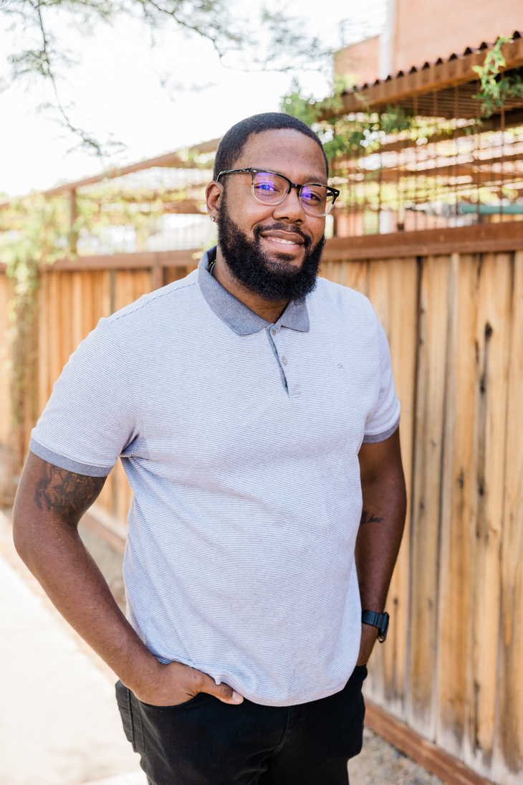



Team Members
Philip Nduati Njoroge
Richard Kioko
Elizabeth
Mercy
CEO and Technical Lead
Marketing and Investor Relations
Commercial Director
Head of Talent and Acquisition

Slide 15



Thank you!
0716211581.
17

